Slide 1
Information Security and Cryptography
CMPE 325
Spring 2022

Slide 2
Cryptanalysis
Kerckhoffs’ Principle
The security of a cryptosystem must lie in the choice of its keys only; everything else (including the algorithm itself) should be considered public knowledge.
Cryptanalysis
Cryptanalytic attacks rely on the nature of the algorithm plus perhaps some knowledge of the general characteristics of the plaintext or even some sample plaintext–ciphertext pairs. This type of attack exploits the characteristics of the algorithm to attempt to deduce a specific plaintext or to deduce the key being used.

Slide 3
Cryptanalysis
The objective of the adversary is to determine the key, hence the plaintext.
Today we will study cryptanalysis of classical encryption algorithms.
Substitution Cipher
Vigènere Cipher
Hill Cipher
We will also study:
Affine Cipher,
Some more math…
Cryptanalysis for modern cryptographic algorithms, later on.

Slide 4
Cryptanalysis
What is the nature of the algorithm?
How strong is the algorithm?
How can we exploit it?
…
It there any way to make it difficult for the adversary?
…
Notes:
We assume that the plaintext string is ordinary English text, without punctuation or “spaces.”
(This makes cryptanalysis more difficult than if punctuation and spaces were encrypted.)

Slide 5
Attack Model
Attack Model specifies the information available to the adversary when he mounts his attack.
Models:
ciphertext-only attack
The opponent possesses a string of ciphertext, y (or C).
known plaintext attack
The opponent possesses a string of plaintext, x (or P), and the corresponding ciphertext, y.
chosen plaintext attack
The opponent has obtained temporary access to the encryption machinery. Hence he can choose a plaintext string, x, and construct the corresponding ciphertext string, y.
chosen ciphertext attack
The opponent has obtained temporary access to the decryption machinery. Hence he can choose a ciphertext string, y, and construct the corresponding plaintext string, x.

Slide 6
Recall Substitution Cipher
Z_{n}= {0, 1, …, n-1}

Slide 7
Permutation in Substitution Cipher
Encryption algorithm is a random permutation, π
a | b | c | d | e | f | g | h | i | j | k | l | m | n | o | p | q | r | s | t | u | v | w | x | y | z
G | D | E | R | A | K | N | I | L | O | Q | S | U | B | M | X | T | C | Z | P | F | H | Y | J | W | V
So, e_{π}(a)=G, e_{π}(k)=Q
Dencryption algorithm is inverse of permutation π, π⁻¹
A | B | C | D | E | F | G | H | İ | J | K | L | M | N | O | P | Q | R | S | T | U | V | W | X | Y | Z
e | n | r | b | c | u | a | v | h | x | f | i | o | g | j | t | k | d | l | q | m | h | y | p | w | s

Slide 8
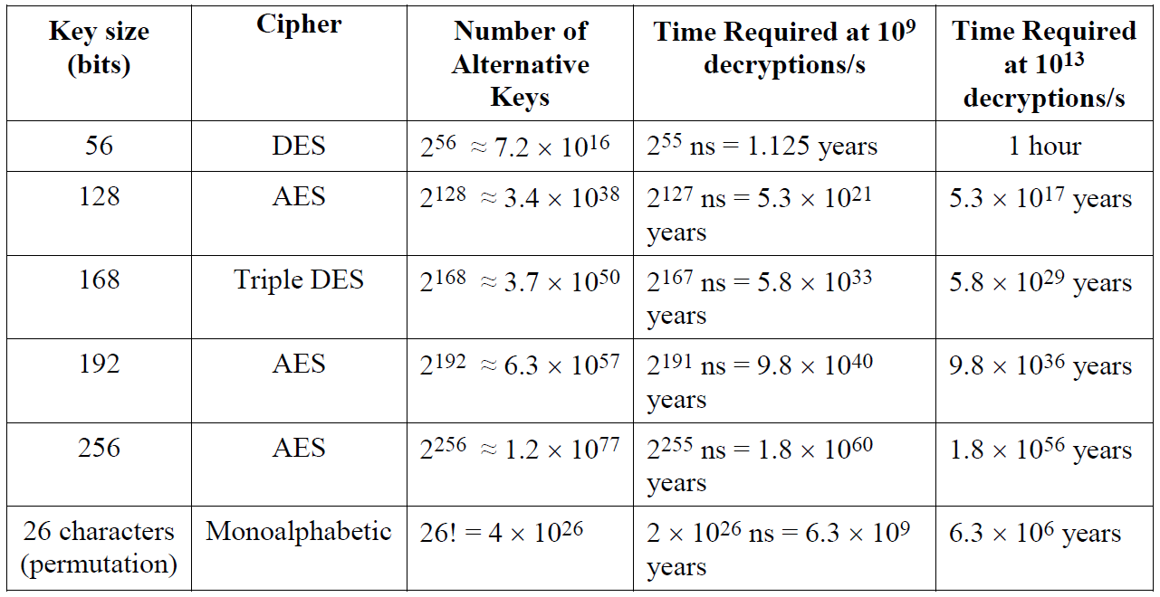
Scale of Substitution Cipher
Number of possible permutations 26!=4.0*10²⁶.
Exhaustive key search (Brute Force) is infeasible.
BUT!!

Slide 9
Cryptanalysis of Substitution Cipher
The permutation can have any ordering but it uses same matching at each time.
We can make use of the characteristic of language.
Frequency of letters.
Digrams, trigrams.

Slide 10
Cryptanalysis of the Substitution Cipher
Ciphertext obtained from a Substitution Cipher:
YIFQFMZRWQFYVECFMDZPCVMRZWNMDZVEJBTXCDDUMJ
NDIFEFMDZCDMQZKCEYFCJMYRNCWJCSZREXCHZUNMXZ
NZUCDRJXYYSMRTMEYIFZWDYVZVYFZUMRZCRWNZDZJJ
XZWGCHSMRNMDHNCMFQCHZJMXJZWIEJYUCFWDJNZDIR
Letter frequency

Slide 11
Cryptanalysis of the Substitution Cipher
Since Z occurs significantly more often than any other ciphertext character, we might conjecture that d_{K}(Z) = e.
The remaining ciphertext characters that occur at least ten times (each) are C, D, F, J,M, R,Y.
We might expect that these letters are encryptions of (a subset of) t, a, o, i, n, s, h, r.
It is not obvious to distinguish them.

Slide 12
Cryptanalysis of the Substitution Cipher
Lets look at the digrams.
The most common digrams are
DZ and ZW (four times each),
NZ and ZU (three times each),
RZ, HZ, XZ, FZ, ZR, ZV, ZC, ZD, and ZJ (twice each).
Since ZW occurs four times and WZ not at all, and W occurs less often than many other characters, we might guess that d_{K}(W) = d.

Slide 13
Cryptanalysis of the Substitution Cipher
If we proceed on the assumption that d_{K}(Z) = e and d_{K}(W) = d, we might look back at the ciphertext and notice that we have ZRW occurring near the beginning of the ciphertext, and RW occurs again later on.
Since R occurs frequently in the ciphertext and nd is a common digram, we might try d_{K}(R) = n as the most likely possibility.

Slide 14
Additional Frequency Features
Digram frequencies
Common digraphs: EN, RE, ER, NT, TH
Trigram frequencies
Common trigrams: THE, ING, THA, ENT
Vowels other than E rarely followed by another vowel.
The letter Q is followed only by U.
…

Slide 15
Cryptanalysis of the Substitution Cipher
At this point, we have the following:
The rest is on you…

Slide 16
Substitution Cipher counter measures against Frequency Analysis
Using nulls
e.g., using numbers from 1 to 99 as the ciphertext alphabet, some numbers representing nothing and are inserted randomly
Deliberately misspell words
e.g., “Thys haz thi ifekkt off diztaughting thi ballans off frikwenseas”
Homophonic substitution cipher
each letter is replaced by a variety of substitutes
These make frequency analysis more difficult, but not impossible
Notes:
Can still be broken, by using frequency features beyond single character frequency.
E.g., q is followed only by u.

Slide 17
Recall Vigènere Cipher
m is the length of the keyword.

Slide 18
Example of Vigènere Cipher
Keyword: deceptive
key : deceptivedeceptivedeceptive
plaintext : wearediscoveredsaveyourself
ciphertext : ZECVTWQNGRZGVTWAVZHCQYGLMGJ
a | b | c | d | e | f | g | h | i | j | k | l | m | n | o | p | q | r | s | t | u | v | w | x | y | z
0 | 1 | 2 | 3 | 4 | 5 | 6 | 7 | 8 | 9 | 10 | 11 | 12 | 13 | 14 | 15 | 16 | 17 | 18 | 19 | 20 | 21 | 22 | 23 | 24 | 25
Is it possible to guess the keyword?

Slide 19
Cryptanalysis of Vigènere Cipher
We need to:
Indentify the key length,
Find out repeating patterns, and smaller substitution parts in length of key,
Solve the resulting substitution using frequency information of letters.

Slide 20
Cryptanalysis of Vigènere Cipher
Kasiski test:
It is based on the observation that two identical segments of plaintext will be encrypted to the same ciphertext whenever their occurrence in the plaintext is δ positions apart, where δ ≡0 (mod m).
Conversely, if we observe two identical segments of ciphertext, each of length at least three, say, then there is a good chance that they correspond to identical segments of plaintext.

Slide 21
His Observation
Key :K I N G K I N G K I N G K I N G K I N G K I N G
Plain text :T H E S U N A N D T H E M A N I N T H E M O O N
Cipher text :B P R Y E V N T N B U K W I A O X B U K W W B T

Slide 22
Cryptanalysis of Vigènere Cipher
Kasiski test works as follows:
Search the ciphertext for pairs of identical segments of length at least three, (identical segments of plaintext, will be encrypted to the same ciphertext)
record the distance between the starting positions of the two segments.
If we obtain several such distances, say δ₁, δ ₂ , . . ., then we would conjecture that m divides all of the δ _{i}’s, and hence m divides the greatest common divisor of the δ _{i} ’s.

Slide 23
Example Vigènere Ciphertext
ADQYS MIUSB OXKKT MIBHK IZOOO
EQOOG IFBAG KAUMF VVTAA CIDTW
MOCIO EQOOG BMBFV ZGGWP CIEKQ
HSNEW VECNE DLAAV RWKXS VNSVP
HCEUT QOIOF MEGJS WTPCH AJMOC
HIUIX
Given encrypted text, find the plain text.

Slide 24
Repetitions
Letters | Start | End | Distance | Factors
MI | 5 | 15 | 10 | 2, 5
OO | 22 | 27 | 5 | 5
OEQOOG | 24 | 54 | 30 | 2, 3, 5
FV | 39 | 63 | 24 | 2, 2, 2, 3
AA | 43 | 87 | 44 | 2, 2, 11
MOC | 50 | 122 | 72 | 2, 2, 2, 3, 3
QO | 56 | 105 | 49 | 7, 7
PC | 69 | 117 | 48 | 2, 2, 2, 2, 3
NE | 77 | 83 | 6 | 2, 3
SV | 94 | 97 | 3 | 3
CH | 118 | 124 | 6 | 2, 3

Slide 25
Estimate of key length
OEQOOG is probably not a coincidence
Two character repetitions may be chance.
Key length may be 1, 2, 3, 5, 6, 10, 15, or 30
Most others (7/10) have 2 in their factors
Almost as many (6/10) have 3 in their factors.
Begin with length of 2 × 3 = 6.

Slide 26
Cryptanalysis of Vigènere Cipher
Coincidence: Picking two letters at random from a message that are identical.
Index of coincidence:
Measures the probability that two random elements of the n-letters string x are identical.
Suppose x = x₁x₂ x_{n} is a string of n alphabetic characters.
The index of coincidence of x, denoted I_{c}(x), is defined to be the probability that two random elements of x are identical, when i and j are uniformly randomly chosen from [1..n].

Slide 27
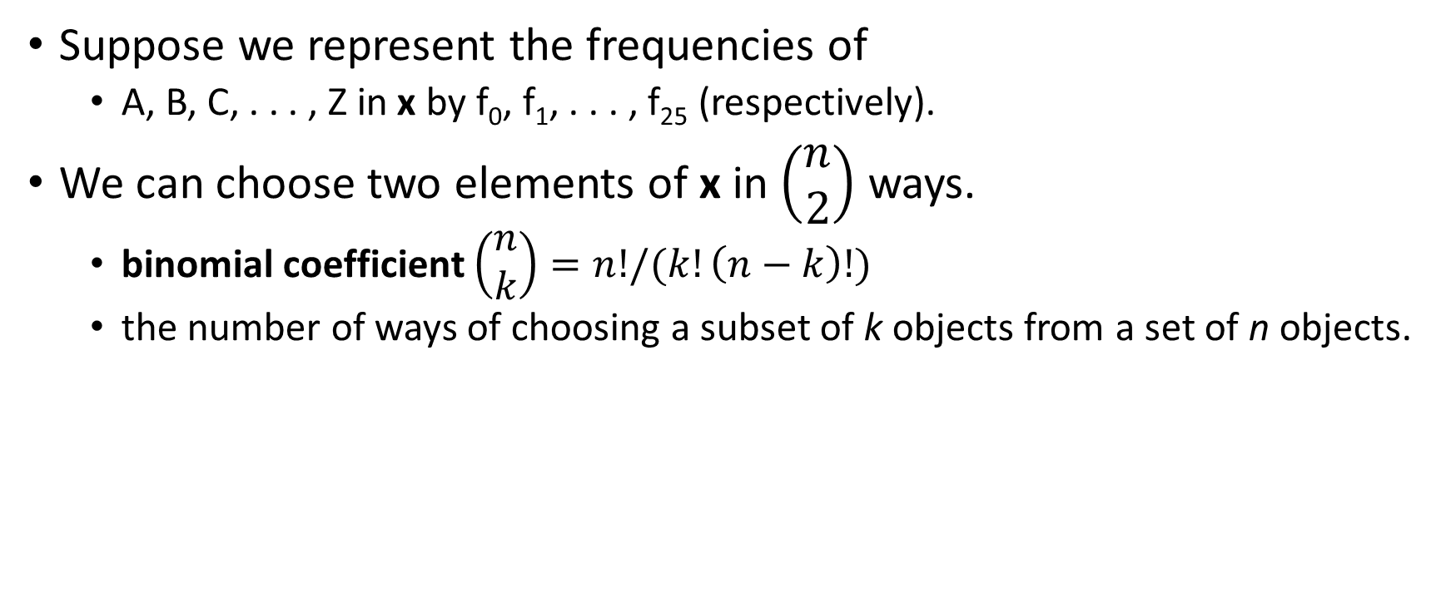
Cryptanalysis of Vigènere Cipher
Suppose we represent the frequencies of
A, B, C, . . . , Z in x by f₀, f₁, . . . , f₂₅ (respectively).
We can choose two elements of x in $\left(\begin{matrix}n \\ 2\end{matrix}\right)$ ways.
binomial coefficient $\left(\begin{matrix}n \\ k\end{matrix}\right)=n!/(k!\left(n−k\right)!)$
the number of ways of choosing a subset of k objects from a set of n objects.

Slide 28
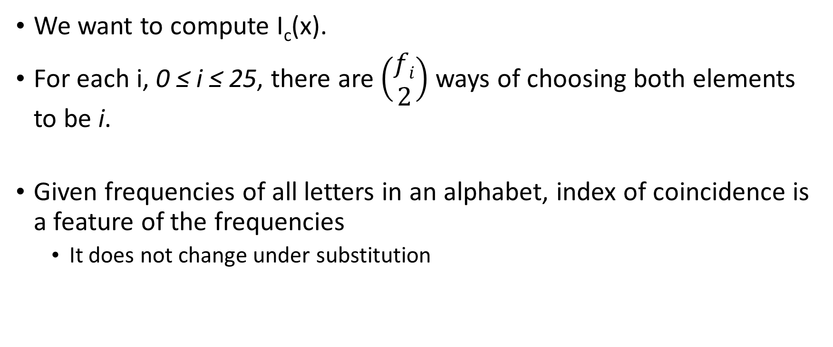
Cryptanalysis of Vigènere Cipher
We want to compute I_{c}(x).
For each i, 0 ≤ i ≤ 25, there are $\left(\begin{matrix}fi \\ 2\end{matrix}\right)$ ways of choosing both elements to be i.
Given frequencies of all letters in an alphabet, index of coincidence is a feature of the frequencies
It does not change under substitution

Slide 29
Cryptanalysis of Vigènere Cipher
For English, S = 25 and p_{i} can be estimated:
If m is the key length, then the text ``looks like’’ English text
If m is not the key length, the text ``looks like’’ random text and:

Slide 30
Coincidence Counting - Example
Simple Language: f(A)=0.75, f(B)=0.25
Simple Cipher: Swap A’s and B’s
Left Table: Plaintext and plaintext; probability of coincidence = 62.5%
Right Table: Plaintext and ciphertext; probability of coincidence = 37.5%
Plaintext
Plaintext/Ciphertext
AA | .5625
BB | .0625
AB | .1875
BA | .1875
AA | .1875
BB | .1875
AB | .5625
BA | .0625

Slide 31
Friedman Test
Expected I_{C}
Random: 0.0385
Plaintext: 0.0667
Expected I_{C} by key length
2: 0.052
3: 0.047
4: 0.045
5: 0.044
10: 0.041
Index of Coincidence
Shorter Key
Longer Key
0.0667
0.0385

Slide 32
Compute I_{C} for Example
For our ciphertext, I_{C} = 0.043
Indicates a key of slightly more than 5.
A statistical measure, so it can be in error, but it agrees with the previous estimate (6).
If the key has m characters, then every m^{th} character is enciphered with the same shift.
The string of letters won’t be recognizable.
But its letter frequencies should be the same as English as it’s a monoalphabetic ciphertext.

Slide 33
Splitting Into parts
Divide cipher into 6 (estimated key length) alphabets.
Alphabet I_{C}
AIKHOIATTOBGEEERNEOSAI 0.069
DUKKEFUAWEMGKWDWSUFWJU 0.078
QSTIQBMAMQBWQVLKVTMTMI 0.078
YBMZOAFCOOFPHEAXPQEPOX 0.056
SOIOOGVICOVCSVASHOGCC 0.124
MXBOGKVDIGZINNVVCIJHH 0.043

Slide 34
Frequency Examination
ABCDEFGHIJKLMNOPQRSTUVWXYZ
1 31004011301001300112000000
2 10022210013010000010404000
3 12000000201140004013021000
4 21102201000010431000000211
5 10500021200000500030020000
01110022311012100000030101
HMMMHMMHHMMMMHHMLHHHMLLLLL
Unshifted frequencies (H high, M medium, L low)

Slide 35
Begin Decryption
First matches characteristics of unshifted alphabet
Third matches if I shifted to A
Sixth matches if V shifted to A
Substitute into ciphertext (bold are substitutions, letters from plaintext)
ADIYS RIUKB OCKKL MIGHK AZOTO EIOOL IFTAG PAUEF VATAS CIITW EOCNO EIOOL BMTFV EGGOP CNEKI HSSEW NECSE DDAAA RWCXS ANSNP HHEUL QONOF EEGOS WLPCM AJEOC MIUAX

Slide 36
Look For Clues
AJE in last line suggests “are”, meaning second alphabet maps A into S:
ALIYS RICKB OCKSL MIGHS AZOTO
MIOOL INTAG PACEF VATIS CIITE
EOCNO MIOOL BUTFV EGOOP CNESI
HSSEE NECSE LDAAA RECXS ANANP
HHECL QONON EEGOS ELPCM AREOC
MICAX

Slide 37
Next Alphabet
MICAX in last line suggests “mical” (a common ending for an adjective), meaning fourth alphabet maps O into A:
ALIMS RICKP OCKSL AIGHS ANOTO MICOL INTOG PACET VATIS QIITE ECCNO MICOL BUTTV EGOOD CNESI VSSEE NSCSE LDOAA RECLS ANAND HHECL EONON ESGOS ELDCM ARECC MICAL

Slide 38
Finally!
QI means that U maps into I, as Q is always followed by U:
ALIME RICKP ACKSL AUGHS ANATO MICAL INTOS PACET HATIS QUITE ECONO MICAL BUTTH EGOOD ONESI VESEE NSOSE LDOMA RECLE ANAND THECL EANON ESSOS ELDOM ARECO MICAL
A limerick packs laughs anatomical
Into space that is quite economical
But the good ones I’ve seen
So seldom are clean
And the clean ones so seldom are comical.

Slide 39
Cryptanalysis of Vigènere Cipher
Observation: If Vigènere key is very long, frequency analysis won’t work.
Problem: Long keys are hard to remember.
Solution: Use multiple encryptions.
Enigma

Slide 40
Cryptanalysis of Hill Cipher
The Hill Cipher can be difficult to break with a ciphertext-only attack, but it is broken easily with a known plaintext attack.
Suppose they have at least m distinct plaintext-ciphertext pairs
x_{j} = (x_{1,j}, x_{2,j}, . . . , x_{m,j})
y_{j} = (y_{1,j}, y_{2,j}, . . . , y_{m,j}),
for 1 ≤ j ≤ m, such that y_{j} = e_{K}(x_{j}),
If we define two m*m matrices
X = (x_{i,j}) and Y = (y_{i,j}),
then we have the matrix equation Y = XK

Slide 41
Cryptanalysis of Hill Cipher
Provided that the matrix X is invertible, adversary can compute:
K = X⁻¹Y
If X is not invertible, then it will be necessary to try other sets of m plaintext-ciphertext pairs.

Slide 42
Affine Cipher
Special case of the Substitution Cipher. Uses a function that has multiplication and addition.
The encryption functions are to be in the form of:
e(x) = (ax + b) mod 26 where a, b ∈ Z₂₆.
Such a function is called an Affine Function;
The key is a pair:
k=(a,b)

Slide 43
Affine Cipher Example
k = (15,22)
p=xyz
C=c₁c₂c₃
Affine Function: c_{i}*15+22 (mod 26)
c₁= x*15+22 (mod 26) ≡3 mod 26
c₁= y*15+22 (mod 26) ≡18 mod 26
c₁= z*15+22 (mod 26) ≡7 mod 26
C = DSH
a | b | c | d | e | f | g | h | i | j | k | l | m | n | o | p | q | r | s | t | u | v | w | x | y | z
0 | 1 | 2 | 3 | 4 | 5 | 6 | 7 | 8 | 9 | 10 | 11 | 12 | 13 | 14 | 15 | 16 | 17 | 18 | 19 | 20 | 21 | 22 | 23 | 24 | 25

Slide 44
Affine Cipher
In order that decryption is possible, affine function is injective. ,
In other words, for any y ∈ Z₂₆, we want the congruence to have a unique solution for x.
ax + b ≡ y (mod 26)
ax ≡ y - b (mod 26)

Slide 45
Affine Cipher
Now, as y varies over Z₂₆, so, too, does y-b vary over Z₂₆.
Hence, it suffices to study the congruence ax ≡ y (mod 26) (y ∈ Z₂₆).
We claim that this congruence has a unique solution for every y if and only if
gcd(a, 26) = 1
THEOREM 2.1: The congruence ax≡b (mod m) has a unique solution x∈Z_{m} for every b∈Z_{m} if and only if gcd(a,m) = 1.

Slide 46
Affine Cipher Key size
Since 26 = 2 *13, the values of a∈Z₂₆ such that gcd(a, 26) = 1 are
a = 1, 3, 5, 7, 9, 11, 15, 17, 19, 21, 23, and 25.
The parameter b can be any element in Z₂₆.
b can be any number ∈Z₂₆
Hence the Affine Cipher has 12*26 = 312 possible keys.

Slide 47
Euler’s phi-function (φ)
The number of integers in Z_{m}
that are relatively prime to m is
denoted by φ(m).
(this function is called the Euler’s phi-function).
Think about prime numbers.
More on Euler’s phi-function will be later, RSA.

Slide 48
Multiplicative Inverse
Suppose a∈Z_{m}, the multiplicative inverse of a modulo m, is denoted by
a⁻¹ mod m, is an element a⁻¹∈Z_{m}
such that aa ⁻¹ ≡a ⁻¹ a ≡ 1 (mod m).
5 ⁻¹ = 21,
7 ⁻¹ = 15,
11 ⁻¹ = 19,
…
If the key size is small, then we can find within some trials. But, if the key size is large, we need more efficient techniques to find multiplicative incverse. More will be later, RSA.

Slide 49
Cryptanalysis of Affine Cipher
Can be a good exam question.
Stinson, Section 2.2.1.

Slide 50
Probability Theory
Random Variable
A discrete random variable, X, consists of a finite set X, and a probability distribution defined on X. The probability that the random variable X takes on the value x is denoted Pr[X =x]; sometimes, we will abbreviate this to Pr[x] if the random variable X is fixed. It must be that

Slide 51
Example
Let random variable e₁ denote the outcome (event) of throw one dice (with numbers 1 to 6 on the 6 sides) randomly, then E={1,2,3,4,5,6} and Pr[e₁=i] = 1/6 for 1≤ i ≤ 6
Let random variable e₂ denote the outcome of throw a second such dice randomly
Let random variable S₁ denote the sum of the two dices, then S={0,1,2,…,10}, and
Pr[S₁=2] = Pr[S₁=12] = 1/36
Pr[S₁=3] = Pr[S₁=11] = 2/36 = 1/18 …
Let random variable S₂ denote the sum of the two dices modulo 6, what is the distribution of S₂

Slide 52
Conditional Probabilities
Assume X and Y are two random variables,
then we define:
- joint probability: Pr[x, y] is the probability that
X takes value x and Y takes value y.
- conditional probability: Pr[x|y] is the probability
that X takes on the value x given that Y takes
value y.
Pr[x|y] = Pr[x, y] / Pr[y]
- independent random variables: X and Y
are said to be independent if Pr[x,y] = Pr[x]P[y],
for all x ∈ X and all y ∈ Y.

Slide 53
Bayes’ Theorem
Bayes’ Theorem
If P[y] > 0 then
Corollary
X and Y are independent random variables iff P[x|y] = P[x], for all x ∈ X and all y ∈ Y.

Slide 54
Example
Suppose we consider a random throw of a pair of dice. Let X be the random variable defined on the set X = {2, . . . , 12}, obtained by considering the sum of two dice.
Further, suppose that Y is a random variable which takes on the value D if the two dice are the same (i.e., if we throw “doubles”), and the value N, otherwise. Then we have that Pr[D] = 1/6, Pr[N] = 5/6.
Please check: Pr[D|4] = 1/3 and Pr[4|D] = 1/6, so
Pr[D|4]Pr[4] = Pr[D]Pr[4|D]

